Slide 1


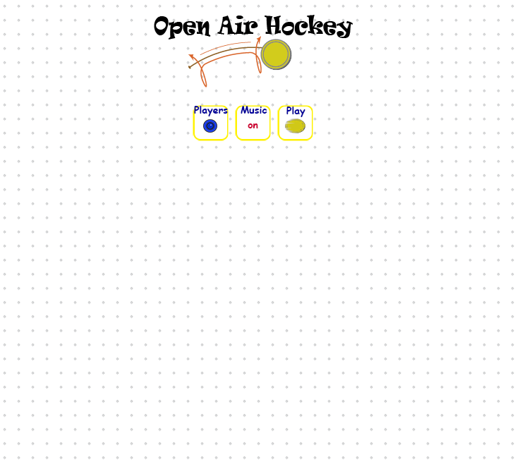
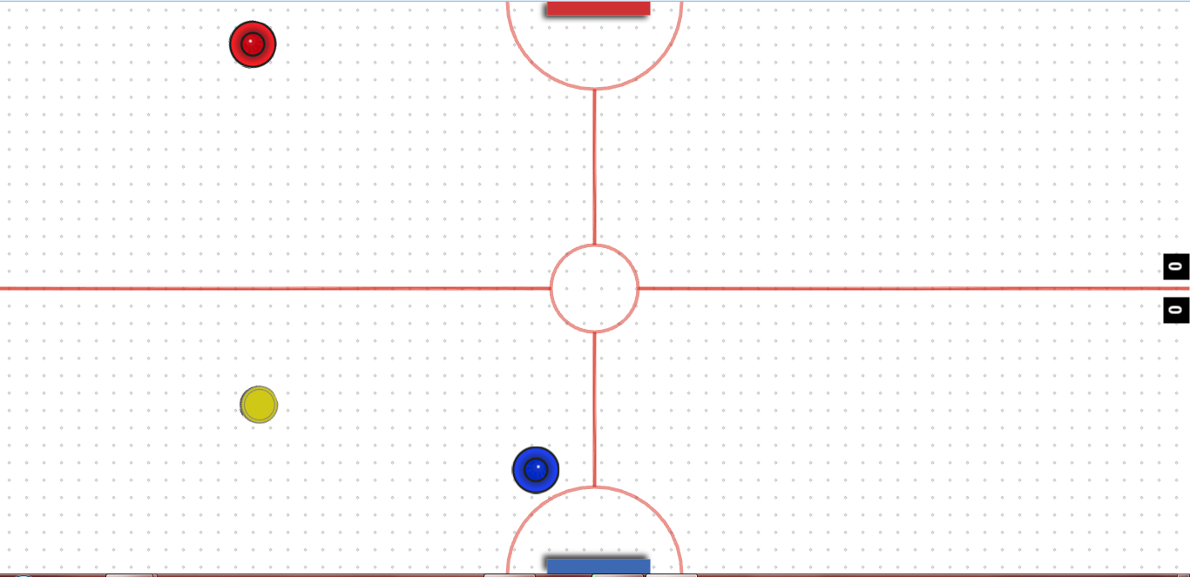
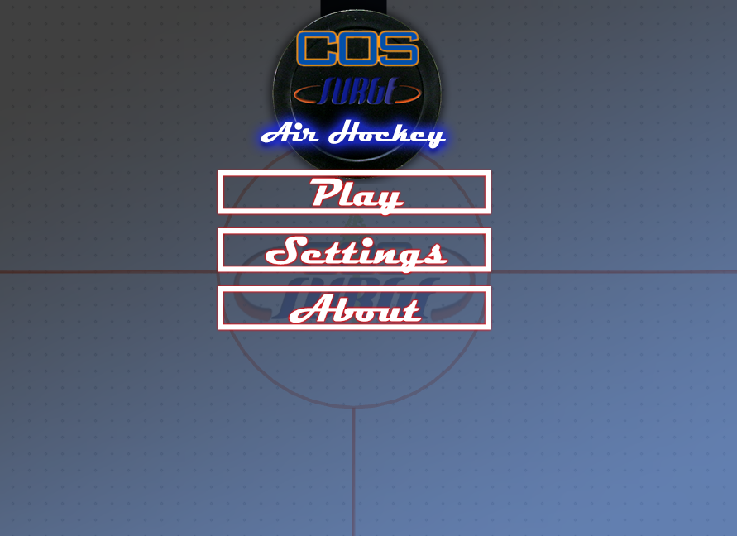
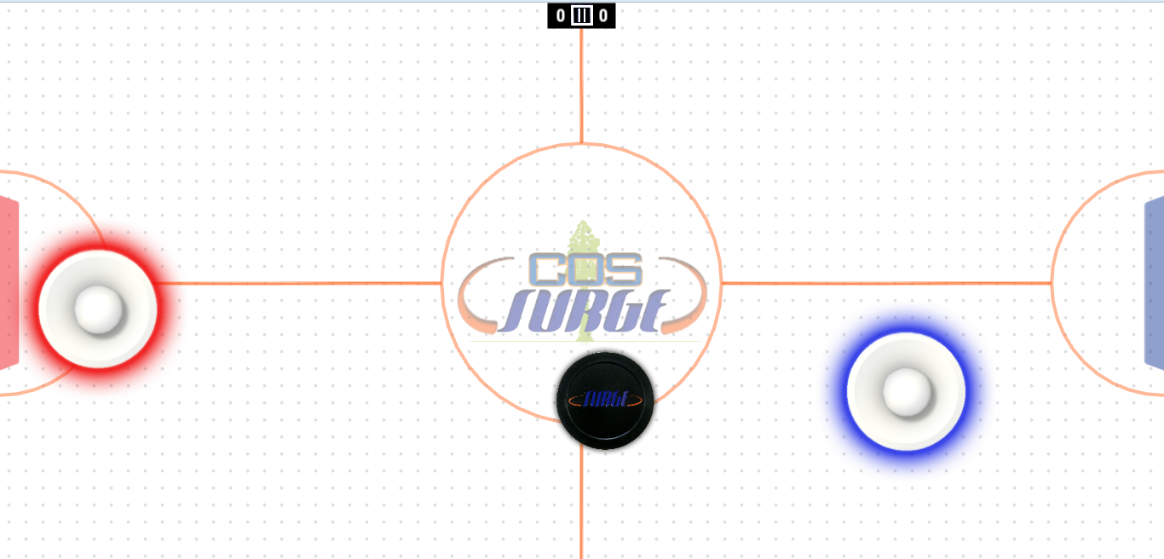
Game Table & Air Hockey Game John Redden, Cory Lewis, Paul Becera Gonzales, Gerald Jumper, ….
¹College of the Sequoias, & California State University, Fresno
²College of the Sequoias & California State Polytechnic University, Pomona
³Natural Resources Conservation Service, United States Department of Agriculture
Introduction
Versions
Code
Built game table and touchscreen game for it..
Prototype
Originally designed and made by john redden.
Objectives
Build Table
Build Game
Have Fun
Required Design Components
Final Game
Art added by: Cory Lewis
Programming done by: John Redden, Gerald Jumper. And Martin.
Some things were required for this project….
Phaser.js (Game Engine)
Designs for table
Designs for game
Art, sound, gameplay, programming, etc..
Acknowledgements
Special thanks to: The SURGE Program, John Redden, Dr. Lawrence Owens, Duane Goodwin.
Funding for this project was provided by the College of the Sequoias SURGE program, which is funded by the US Department of Education MSEIP grant #P120A130106.

